Slide 1
Bootstrap Grid System
Bhaskarasai Chitturi

Slide 2



Viewport
<meta name="viewport" content="width=device-width,
initial-scale=1">
• The viewportmeta tag:
– Ensures that the screen width is set to the device width
and the content is rendered with this width in mind
– Designing the websites to be responsive to the size of the
viewport
• Bootstrap grid system
http://getbootstrap.com/docs/4.0/layout/grid/
2

Slide 3
Bootstrap Grid
• Designed to be:
–Responsive
–Mobile first
–Fluid
3

Slide 4
CSS Flexbox Layout
• Simpler and flexible layout options in CSS
• Can easily handle dynamic/unknown size of
content containers
• Direction-agnostic layout
4

Slide 5
Why Flexbox for Bootstrap?
• Easy vertical alignment of content within a parent
element
• Easy reordering of content across devices and
screen resolutions with the help of media queries
• Easy CSS-only equal height columns for your grid-
based layouts
5

Slide 6


















Bootstrap Grid
<div class=“container”>
<div class=“row”>
1
2
3
4
5
6
7
8
9
10
11
12
6

Slide 7
Bootstrap Grid
•
Bootstrap makes available five classes
– XS extra small screen
– smfor small,
– mdfor medium,
– lgfor large, and
– xlfor extra large screen sizes
•
•
Each row in Bootstrap grid system is
divided into 12 columns
Use the classes .col-*, .col-sm-*, col-md-*, and .col-lg-* for defining the layouts for
the various screen sizes
Specify how many columns
•
each piece of
content
will
occupy within a row, all
adding up to 12 or a multiple thereof
7

Slide 8




Bootstrap Grid
<div class=“container”>
<div class=“row”>
<div class=“col-sm-5”>
<div class=“col-sm-7”>
1
2
3
4
5
6
7
8
9
10
11
12
8

Slide 9











Auto-layout Columns
<div class=“container”>
<div class=“row”>
<div class=“col-sm”>
<div class=“col-sm”>
<div class=“col-sm”>
1
2
3
4
5
6
7
8
9
10
11
12
<div class=“col-sm”>
<div class=“col-sm-6”>
<div class=“col-sm”>
9

Slide 10
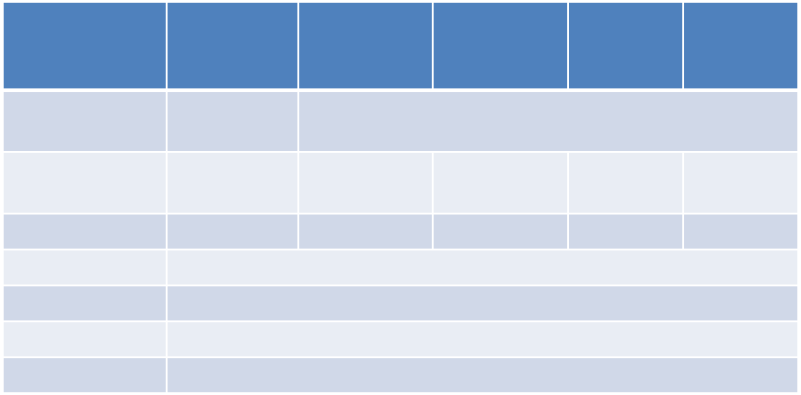
Bootstrap Grid Details
Extra small
<576px
Small
≥576px
Medium
≥768px
Large
≥992px
Extra large
≥1200px
Grid behavior
Horizontal
at all times
None (auto)
Collapsed to start, horizontal above breakpoints
Max container
width
Class prefix
540px
720px
960px
1140px
.col-
.col-sm-
.col-md-
.col-lg-
.col-xl-
# of columns
12
Gutter width
30px (15px on each side of a column)
Nestable
Ye s
Offsets
Ye s
10

Slide 11








Using Column classes
Extra Small Screens
Small, Medium, Large and Extra Large Screens
<div class=“col-
12 col-sm-5”>
<div class=“col-
12 col-sm-5”>
<div class=“col-12 col-
sm-7”>
<div class=“col-
12 col-sm-7”>
11

Slide 12






Nesting Columns
<div class=“container”>
<div class=“row”>
<div class=“col-sm-5”>
<div class=“col-sm-7”>
<div class=“row”>
1
2
3
4
5
6
7
8
9
10
11
12
<div class=“col-sm-9”>
<div
class=“col-
sm-3”>
16

Slide 13
Exercise: Responsive Design and
Bootstrap Grid System
• Create responsive websites using the Bootstrap grid
system
• Customize the CSS classes through your own
additions in a separate CSS file
17

